Slide 1
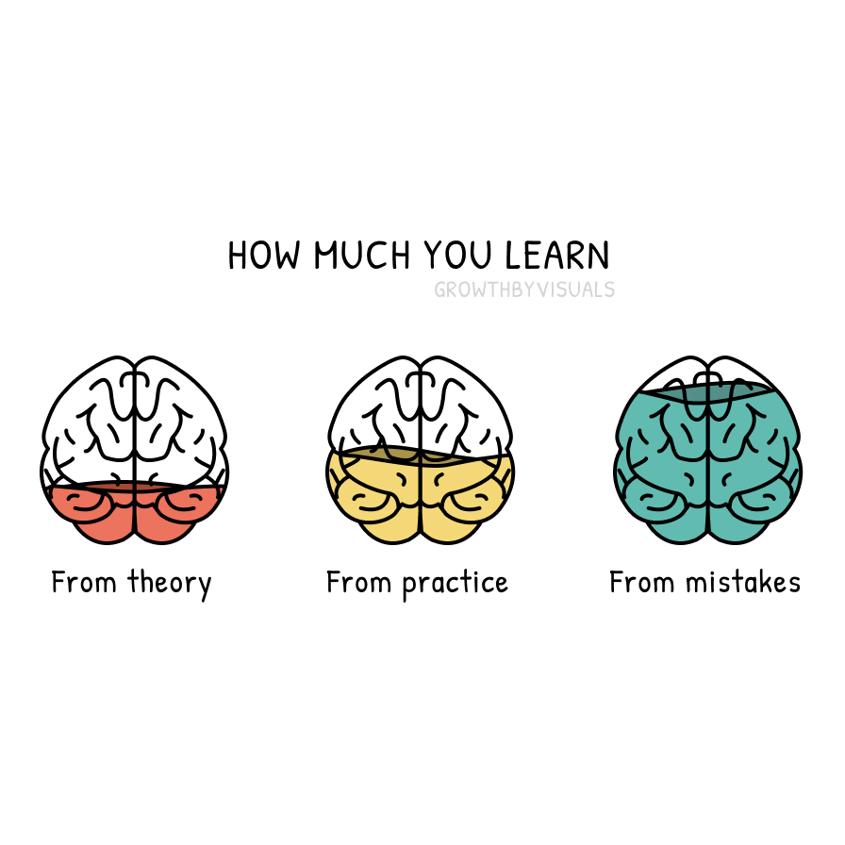
Grades 6-7
Look at the three brains. Which one has the most color? What does that tell you about where learning comes from?
© 2026 Growth by Visuals · growthbyvisuals.com · Individual Teacher License
Licensed for single-teacher classroom use only. Not for redistribution.

Slide 2
Grades 6-8
Think of something you genuinely got better at. Did it involve making mistakes, or did you get it right almost immediately?
© 2026 Growth by Visuals · growthbyvisuals.com · Individual Teacher License
Licensed for single-teacher classroom use only. Not for redistribution.

Slide 3
Grades 7-9
Why do you think mistakes produce more learning than just reading or watching? What happens differently in your brain when something goes wrong?
© 2026 Growth by Visuals · growthbyvisuals.com · Individual Teacher License
Licensed for single-teacher classroom use only. Not for redistribution.

Slide 4
Grades 8-10
Is there something you have been avoiding trying because you were afraid of getting it wrong? What might that avoidance be costing you in terms of learning?
© 2026 Growth by Visuals · growthbyvisuals.com · Individual Teacher License
Licensed for single-teacher classroom use only. Not for redistribution.

Slide 5
Grades 9-11
If mistakes teach more than theory, why does our school system often treat mistakes as something to be minimized or hidden? What would a classroom look like that treated them as the main event?
© 2026 Growth by Visuals · growthbyvisuals.com · Individual Teacher License
Licensed for single-teacher classroom use only. Not for redistribution.

Slide 6
Grades 10-12
Describe a specific mistake that changed the way you think or work. What did smooth success in the same area teach you by comparison?
© 2026 Growth by Visuals · growthbyvisuals.com · Individual Teacher License
Licensed for single-teacher classroom use only. Not for redistribution.

Slide 7
College / Univ.
Think of the most significant academic or professional mistake you have made since starting college. Using the three-brain model, what did that experience teach you that no lecture or textbook could have produced?
© 2026 Growth by Visuals · growthbyvisuals.com · Individual Teacher License
Licensed for single-teacher classroom use only. Not for redistribution.

